Slide 1

Bank Loans Marketing Campaign
LaChandra Ash
November 9, 2022

Slide 2

Bank Marketing Campaign History
Banks created marketing campaigns to gain profit when their revenue begins to decrease.
During the campaigns, they contact their subscribed consumers.
The bank consumers may already have a long term such as housing or personal loan.

Slide 3

The Problem
The Portuguese bank wants to know what steps to take after experiencing a reduction in revenue.
The main explanation, according to analysis, is that their consumers are not making deposits as frequently as they did in the past.
Term deposits allow banks to keep deposits for a certain period of time.
Banks can invest in financial products with higher profit margins to increase their profits.
Additionally, banks have a better chance of convincing term deposit customers to purchase other goods like funds or insurance in order to boost their profits.

Slide 4

The Target Y Variable
Has the client subscribed to a loan program?
Personal loans
Housing Loans
Term Deposit

Slide 5
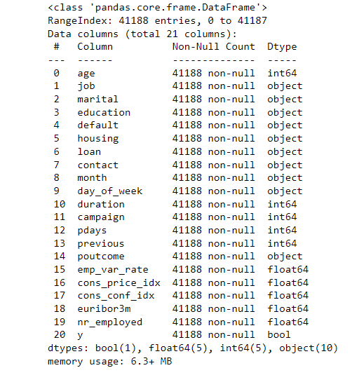
The Bank Dataset
First bullet point here
Second bullet point here
Third bullet point here

Slide 6
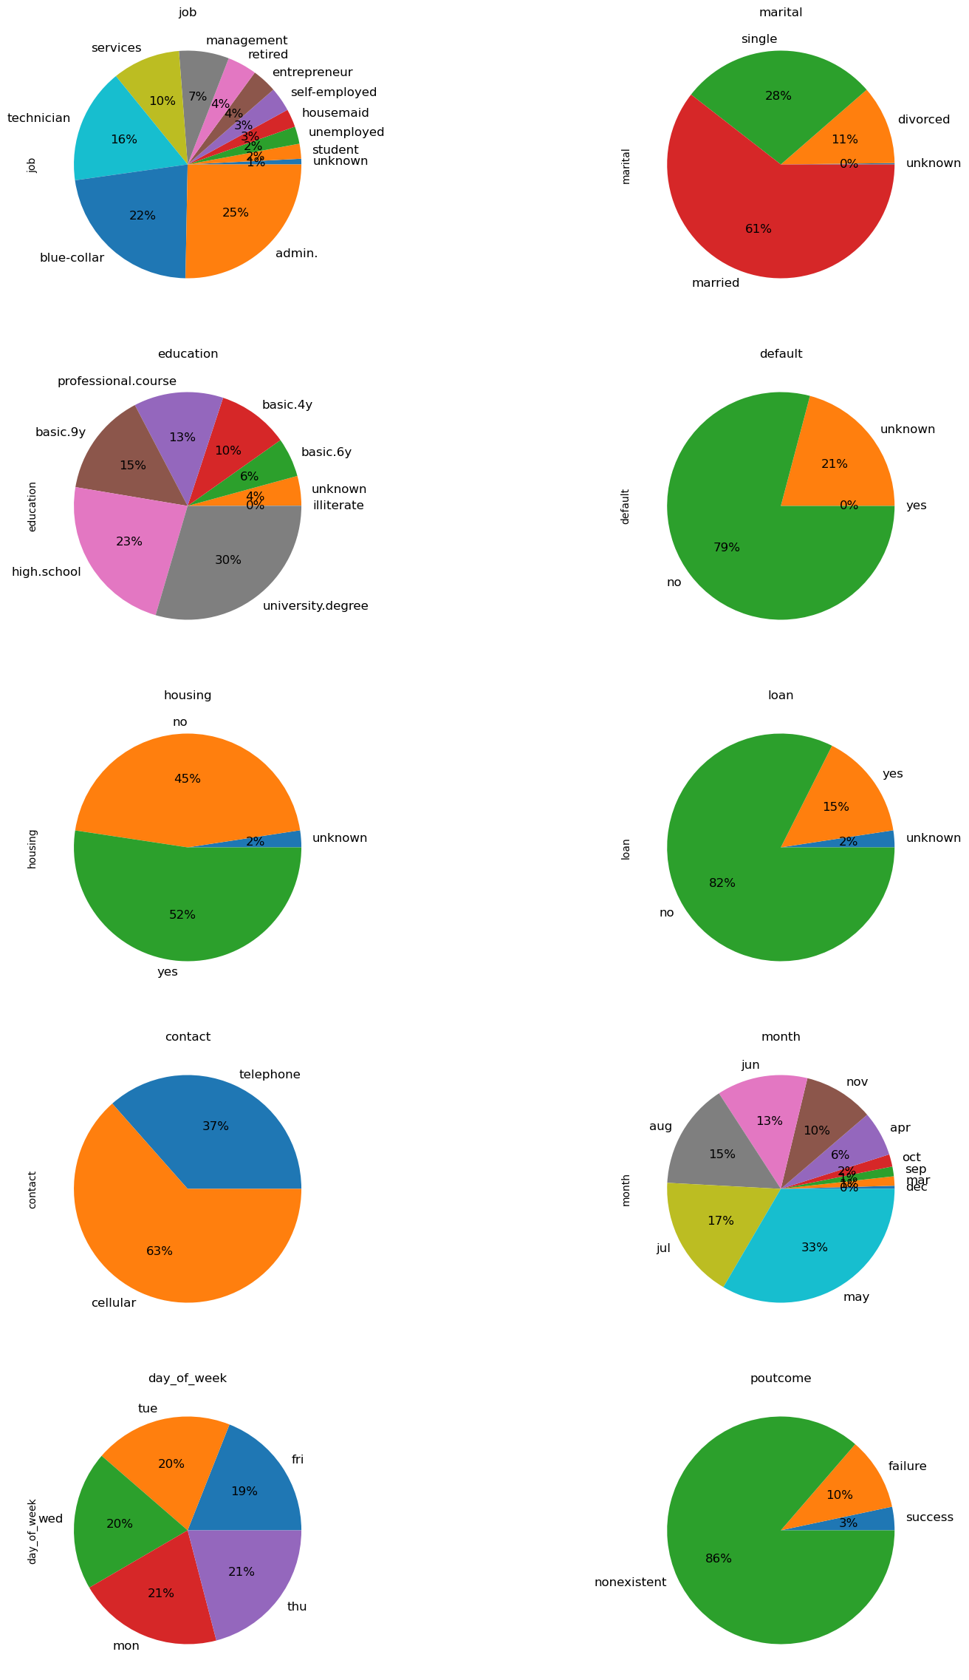
Consumer Job Type
The administration job field has the highest percentage of the bank’s consumers.
The blue-collar is the second most popular job field among the bank’s consumers.
The technician field is the third most popular job field for the bank’s consumers.

Slide 7

Consumer Education
A high percentage of the bank’s consumers graduated from high school.
Consumers who graduated from from high school, most likely obtained a university degree.

Slide 8
Marital Status
Most of the bank’s consumers are married.
Married consumers are best for the term loans because they may have two incomes.
Married consumers will less likely face loan default.

Slide 9
Housing Loan
More bank consumers have housing loans versus consumers without banking loans.
There is a small percentage of bank consumers who the bank is unsure of there housing loan status.

Slide 10
Default
Most of the bank’s consumers did not default on their loan.
Although no consumers defaulted on their loans, there is a low percentage of consumers whose default status is unknown.

Slide 11
Contact
Most consumers were contacted via mobile phone.
Most consumers prefer to be contacted on their cellphone.
Surprisingly, consumers were contacted via their landline telephone.

Slide 12
Personal Loan
Most consumers did not have a personal loan.
Less than 20 percent of the bank’s consumers were subscribed to a personal loan term.

Slide 13
Campaign Months
The campaigns thrived the most in the month of May.
The campaigns were most successful during the summer months.
Campaigns were non-existent during January and February.

Slide 14
Day of Week
Nearly the same percentage of consumers were contacted every day of the work week.
The least percentage of consumers were contacted on Fridays.

Slide 15
Poutcome
The highest percentage of outcome results of the previous campaign contacts are non-existent.
There was a ten percent failure in the outcome results.

Slide 16
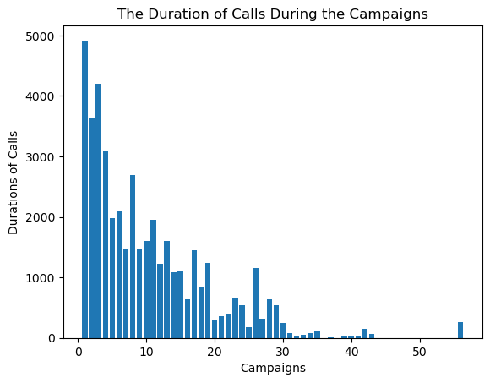
Duration of Calls During Campaigns
Most of the duration of calls were conducted in the beginning of the campaign contacts, and they decreased as the campaign contacts increased.

Slide 17
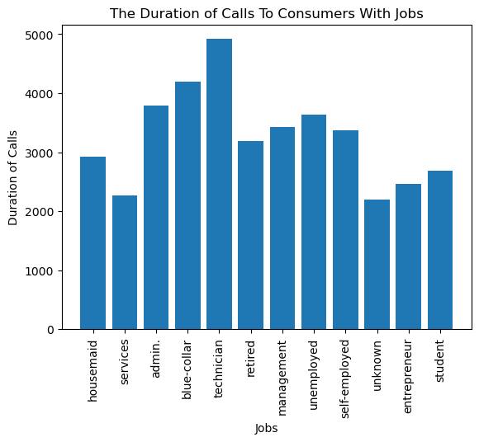
Duration of Calls and Consumers with Jobs
The consumers with technician jobs had the longest duration of calls with the bank’s staff.
The consumers with administration and blue-color jobs had the second longest duration of call with the bank’s staff.
The consumers with services and other types of jobs had the least duration of call with the bank’s staff.

Slide 18
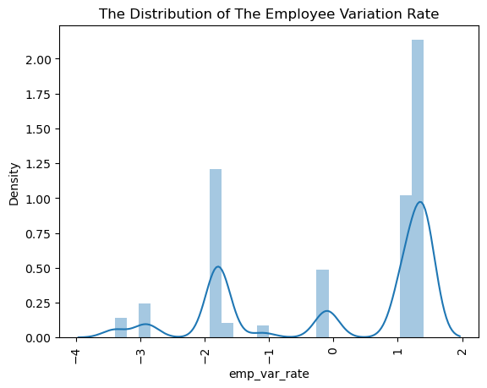
Distribution of Employee Variation Rate
A high turnover rate indicates that the campaign was launched at a time of significant staff mobility caused by economic factors.

Slide 19
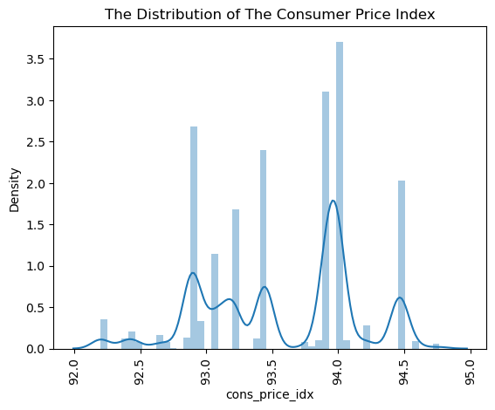
Distribution of Consumer Price Index
The consumer price index is helpful in indicating to potential savers and depositors which areas of the country have the lowest prices for consumer items.

Slide 20
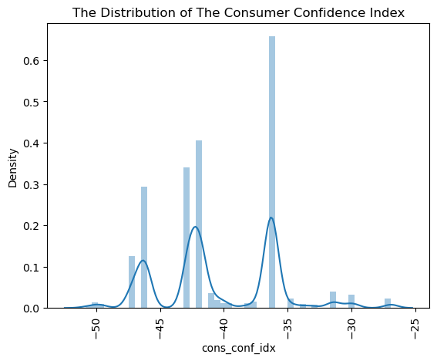
Distribution of the Consumer Confidence Index
The consumer confidence index was somewhat low because people are worried about the uncertain state of the economy.

Slide 21
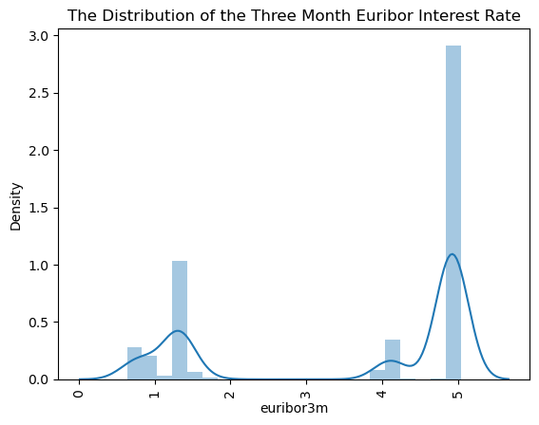
Distribution of the Three Month Euribor Interest Rate
The rates at which they borrow money are quite high.

Slide 22
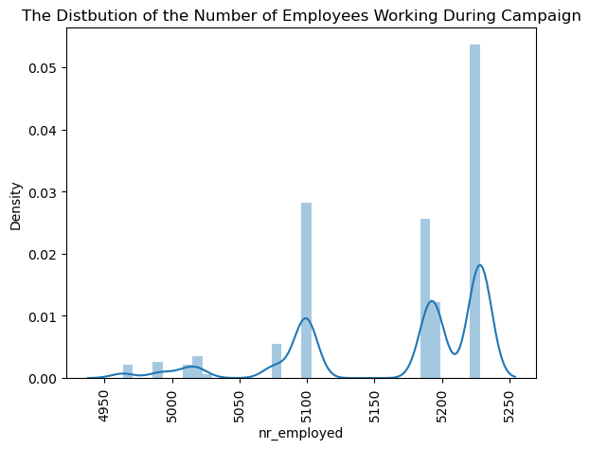
Distribution of the Number of Employees Working During the Campaign
Employee counts were quite high, which is a positive indicator of future financial success.

Slide 23
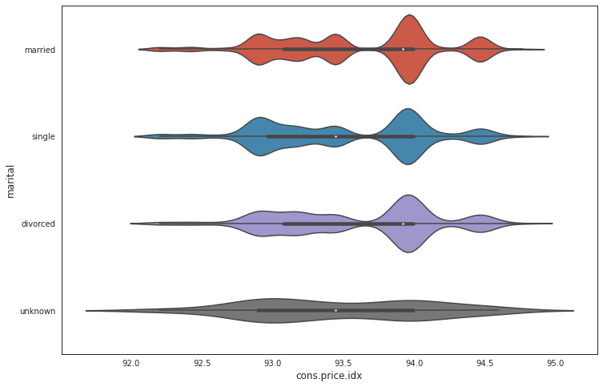
Marital Vs. Consumer Price Index
The married consumers are most likely to be considered before unmarried consumers.
Married consumers have higher consumer price index.

Slide 24

DecisionTreeClassifier Model
The DecisionTreeClassifier resulted in a model accuracy score of 89%.

Slide 25

Naïve Bayes Model
Model accuracy score was 85.6%.
The precision score predicted 95% accuracy score of the bank’s consumers will subscribe to the loan term.
The recall score was 89%.
The f1-score revealed a score of 92%.

Slide 26

Conclusion
The model can be fine tuned by adding another model.
Most of the bank’s consumers were married, had a college and high school degree, and worked in a blue-collar, technician, or administration job field.
The bank contacted the highest number of consumers in the month of May.
Most bank consumers were contacted during the summer, and the campaign contacts decreased as the year went by.
The campaigns did not occur in the months of January and February.
Married consumers will more than likely qualify for the loan term because of their consumer price index.

